Slide 1
Machine Learning Fundamentals and Decision Tree Learning
SIMATS ENGINEERING Saveetha Institute of Medical and Technical Sciences Chennai-602105.
ITA0612-Machine Learning
Technical Presentation
Guided By:
Dr. Shri Vindhya
SIMATS Engineering
Presented by:
Divyesh S P (192424147)

Slide 2
Introduction
Machine Learning
Definition
Machine Learning (ML) is a branch of Artificial Intelligence.
It enables computers to learn from data without being explicitly programmed.
ML is used to make predictions and decisions.
Examples
Face Recognition
Spam Email Detection
Netflix Recommendations
Self-driving Cars

Slide 3
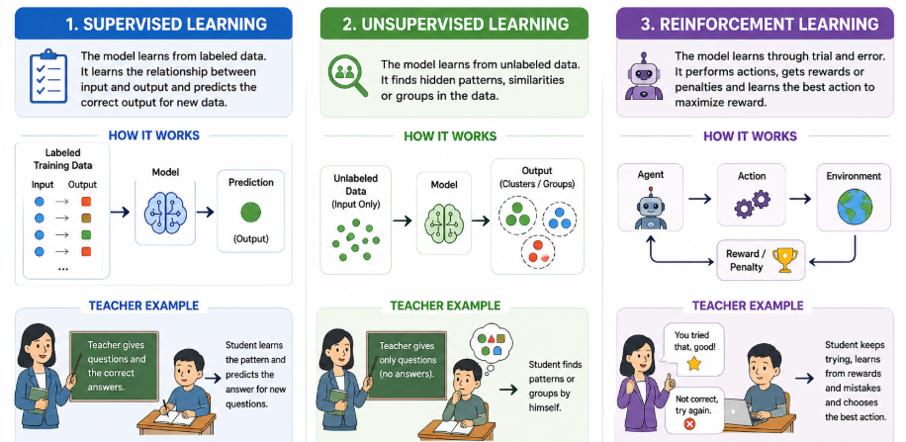
Types of Learning Problems

Slide 4
Learning Perspectives
Symbolic Approach
Uses logical rules
Knowledge represented as symbols
Human-readable
Statistical Approach
Uses probability and statistics
Learns patterns from data
Most modern ML algorithms use this approach

Slide 5
Challenges in Machine Learning
Data Quality
Missing values
Noisy data
Incorrect labels
Overfitting
Model memorizes training data
Poor testing performance
Computational Complexity
Large datasets require more time
High memory usage

Slide 6
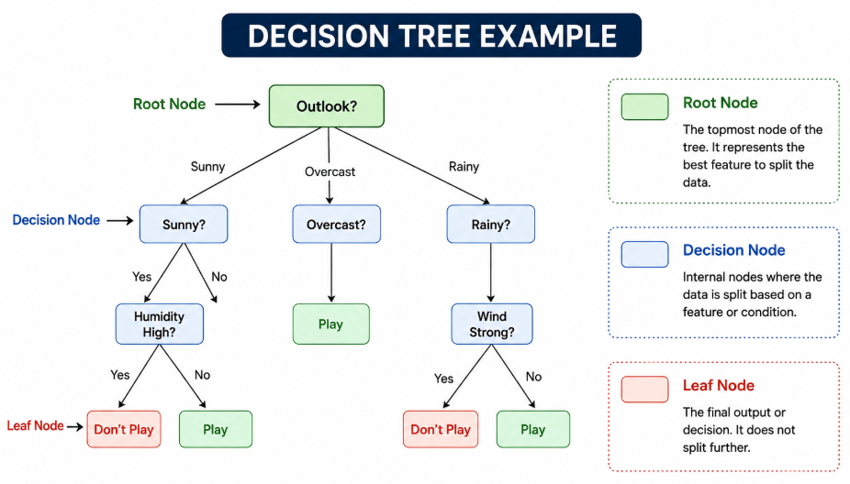
Introduction to Decision Trees
What is a Decision Tree?
A Decision Tree is a supervised learning algorithm used for classification and prediction.

Slide 7
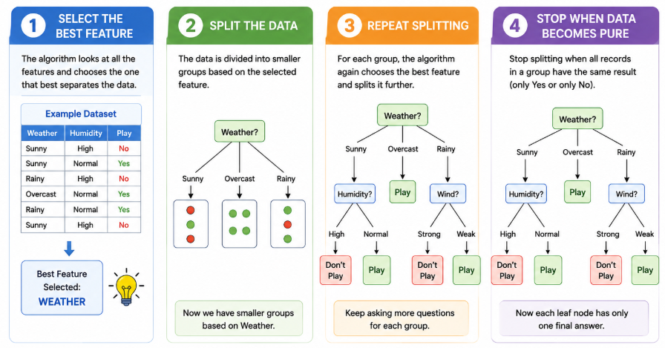
How Decision Tree Works

Slide 8
Entropy
What is Entropy?
Entropy measures the uncertainty or impurity of data.
Formula
Entropy(S) = - Σ Pi log₂ Pi
Interpretation
Entropy = 0 → Pure data
High Entropy → Mixed data

Slide 9
Information Gain
Information Gain
Information Gain measures how much uncertainty is reduced after splitting.
Higher Information Gain = Better Feature
Decision trees always choose the feature with the highest Information Gain.

Slide 10
Tree Pruning
What is Pruning?
Removing unnecessary branches from the tree.
Types
Pre-Pruning
Stop tree growth early
Post-Pruning
Remove branches after construction
Benefits
Reduces overfitting
Improves accuracy

Slide 11
Advantages & Limitations
Advantages
Easy to understand
Easy to visualize
Handles numerical and categorical data
Fast prediction
Limitations
Overfitting
Sensitive to noisy data
Can become very large

Slide 12
Conclusion
Summary
Machine Learning enables computers to learn from data.
Three major learning types:
Supervised
Unsupervised
Reinforcement
Decision Trees are simple yet powerful classification algorithms.
Entropy and Information Gain help build efficient trees.
Decision Trees are widely used in real-world applications.

Slide 13
Thank You

